Slide 1

I/o Access patterns in hpc applications: A 360-Degree survey
Jean luca bez, suren byna & shadi Ibrahim

Slide 2

Introduction : >HPC i/o stack >i/o access patterns >Survey methodology >baseline taxonomy

Slide 3
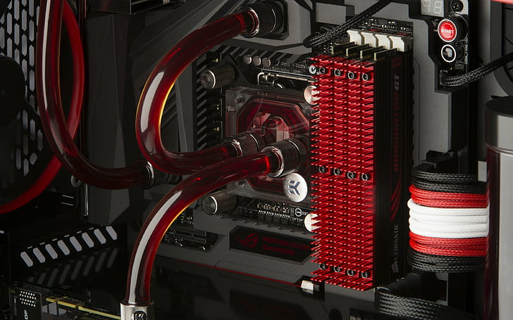
Challenges : >i/o tuning >real-time detection >bridging gaps >taxonomy in auto-tuning

Slide 4

Future plans & directions: >Taxonomy extension >runtime detection >optimization strategies

Slide 5
Thank You for listening

